Slide 1

ECE 530 Cloud Computing
Ioannis Papapanagiotou
Distributed Systems

Slide 2
What is a distributed system
Free On-line Dictionary of Computing
A collection of (probably heterogeneous) automata whose distribution is transparent to the user so that the system appears as one local machine. This is in contrast to a network, where the user is aware that there are several machines, and their location, storage replication, load balancing and functionality is not transparent. Distributed systems usually use some kind of client-server organization.

Slide 3
More definition
A distributed system is a collection of independent computers that appear to the users of the system as a single computer
[Andrew Tanenbaum]
A distributed system is several computers doing something together. Thus, a distributed system has three primary characteristics: multiple computers, interconnections, and shared state
[Michael Schroeder]

Slide 4
Distributed Systems Problems
Failure Detectors
Time and Synchronization
Global States and Snapshots
Multicast Communications
Mutual Exclusion
Leader Election
Impossibility of Consensus
Peer to peer systems – Napster, Gnutella
Chord
Cloud Computing
Hadoop
Networking and Routing
Sensor Networks
Measurements from real systems
Datacenter Disaster Case Studies
Basic Theoretical
Concepts
Cloud Computing
What Lies
Beneath

Slide 5
Distributed Systems Problems
RPCs & Distributed Objects
Concurrency Control
2PC/3PC and Paxos
Replication Control
Gossiping
Key-value and NoSQL stores
Stream Processing
Self-stabilization
Distributed File Systems
Distributed Shared Memory
Security and Byzantine Fault-tolerance
Basic Building Blocks
Distributed Services
(e.g., storage)
Cloud Computing
Old but Important
Important

Slide 6
Distributed System Design Goals
Common Goals:
Heterogeneity
Robustness
Availability
Transparency
Concurrency
Efficiency
Scalability
Security
Openness
(Also: consistency, CAP, partition-tolerance, ACID, BASE, and many others … )
What are these?

Slide 7
Goals
Heterogeneity: different types of servers, of networks, of applications, of services, of consistency guarantees
Robustness: fault-tolerance to a variety of failures
Availability: of data, of operations, in spite of failures and network partitions
Transparency: provide an abstraction of one property while allowing sufficient flexibility at run-time, e.g., clouds, transactions, virtual synchrony, sequential consistency, etc
Concurrency: support many clients (millions)
Efficiency: fast operations, e.g., reads and writes in NoSQL
Scalability: many operations per second in spite of thousands of servers, millions of clients
Security: system should be protected from attackers and bugs, e.g., encryption and signatures
Openness: each service/protocol can build on other services/protocols, e.g., layered or stacked architecture

Slide 8
Distributed Systems Intricacies
Synchronization: multiple clocks (difficult to agree on exact time)
Concurrency: multiple simultaneous accesses potentially conflicting.
Failures: high probability of failures (too many components). Complex failure modes (single, multiple simultaneous, network partition, …)
Consensus: difficult to reach consensus (odds includes failures, lack of synchronization, …)
more …

Slide 9
Distributed Computing Models
Client/Server Approach
Multi-tier Approach
Peer-to-Peer Approach
Agent based systems
Mobile Code (Applets, mobile agents, ..)
Service-oriented computing
Service registration/discovery
Service composition
Cloud Computing

Slide 10
The Emerging Computing Model: Cloud, Edge & Beneath
Cheaper to provide services to a thin client than to maintain a fat client in a changing world (service Science)
Besides the Cloud, all other computing infrastructures become simply Edge Devices to the Cloud
Does IoT count in this new world of Clouds? Are Sensors Edge Devices?

Slide 11
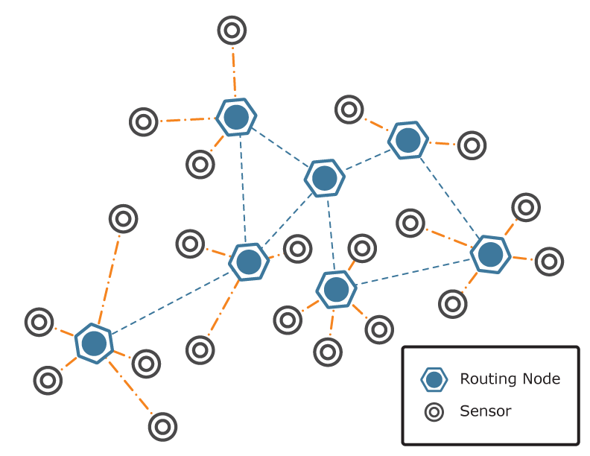
Cloud, Edge & Beneath Sensors – to – Edge; Edge – to- Cloud
Cloud Computing
In Network
Computing
The Case for the Edge

